Slide 1
SALES ANALYTICS DASHBOARD
ELEVATE LABS Data Analyst Internship – Task 4
Prepared by : Thomas Aldo P
Tools: Microsoft Power BI | Power Query | DAX
Dataset: Sample Superstore Dataset

Slide 2
Project Overview
Objective:
Design an interactive Power BI dashboard that enables business stakeholders to monitor sales performance, profitability, customer segments, and regional trends through dynamic visualizations and filters.
Dataset: Sample Superstore
Key Attributes:
Order Date
Sales
Profit
Quantity
Region
Category
Sub-Category
Customer Segment
Product Information
Tools Used:
Microsoft Power BI
Power Query
DAX
CSV Dataset
Dashboard Features:
KPI Cards
Interactive Slicers
Time-Series Analysis
Regional Sales Analysis
Category Performance
Profitability Analysis

Slide 3
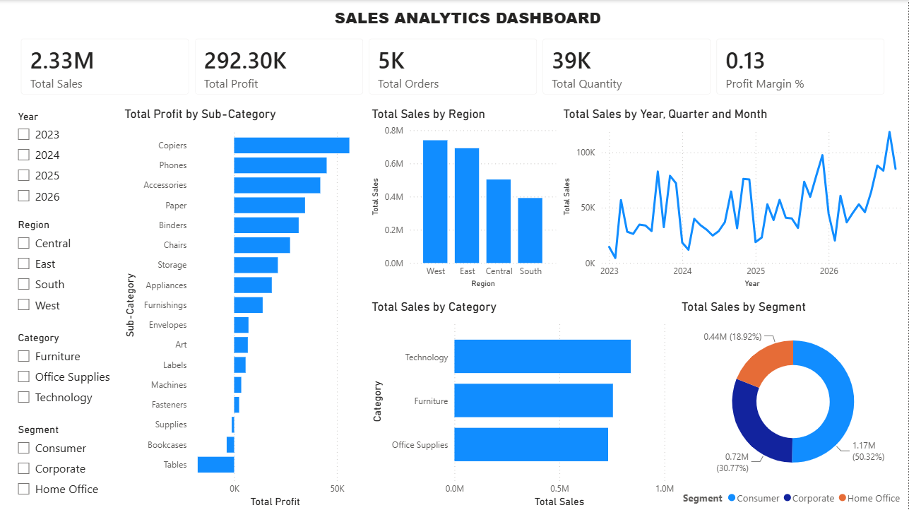
Dashboard includes:
Total Sales
Total Profit
Total Orders
Total Quantity
Profit Margin
Sales Trend
Sales by Category
Profit by Sub-Category
Sales by Region
Sales by Segment
Interactive Filters

Slide 4
Key Insights:
Total Sales reached 2.33 Million.
Total Profit was 292.30 Thousand with a 12.56% Profit Margin.
Technology generated the highest sales.
West region recorded the highest sales.
Consumer segment contributed the largest share of revenue.
Tables showed negative profitability and require further analysis.

Slide 5
BUSINESS RECOMMENDATIONS:
Increase focus on Technology products.
Review pricing and discounts for low-profit products.
Strengthen marketing in high-performing regions.
Use dashboard filters for better decision-making.
Monitor KPIs regularly to improve business performance.

Slide 6
CONCLUSION:
This dashboard provides an interactive overview of sales performance using Power BI.
It helps users monitor key metrics, identify business trends, compare regional and category performance, and make data-driven decisions through interactive visualizations.

